Slide 1
Subprograms
CMSC 330: Programming Languages

Slide 2
Why Do We Need Subprograms
Programs can be very large
Repeating code is bad
We need a way to:
break problems into smaller pieces
reuse code
organize logic
Subprograms solve these problems

Slide 3
What Is A Subprogram?
A subprogram is a named sequence of statements that performs a task and can be invoked
Historically, a subprogram can be
A function which returns a value
A procedure which performs an action with no return value
In modern languages (C/C++/Java/OCaml), subprograms are just functions
Java: value returning vs. void
Ocaml: value returning vs. unit type ()

Slide 4
Subprogram Example
int add(int x, int y) {
return x + y;
}
Name: add
Input: x, y
Return value: x + y
You can call a subprogram:
int result = add (3, 4);

Slide 5
Common Terms
Subprogram definition
describes the interface to and the actions of the subprogram abstraction
Subprogram call
explicit request that a subprogram be executed
Signature or Parameter profile of a subprogram
name + number, order, and types of its parameters
Protocol
signature and, if it is a function, its return type
Subprogram declaration
provides the protocol, but NOT the BODY, of subprogram
Function declarations in C and C++ are called prototypes

Slide 6
Abstraction
Two fundamental abstraction facilities:
Process abstraction
Treating a sequence of steps as a single operation
Our focus now: subprograms
Data abstraction
Building Abstract Data Types (ADTs)
Covered in later chapters

Slide 7
Process Abstraction
Goal: Name a related group of statements and refer to it when needed
Every subprogram has exactly one entry point
A calling subprogram (caller) is suspended during the execution of the called subprogram (callee)
Control will always return to the caller when the callee terminates
Notes:
A function always begins execution at a single, well-defined starting location.

Slide 8
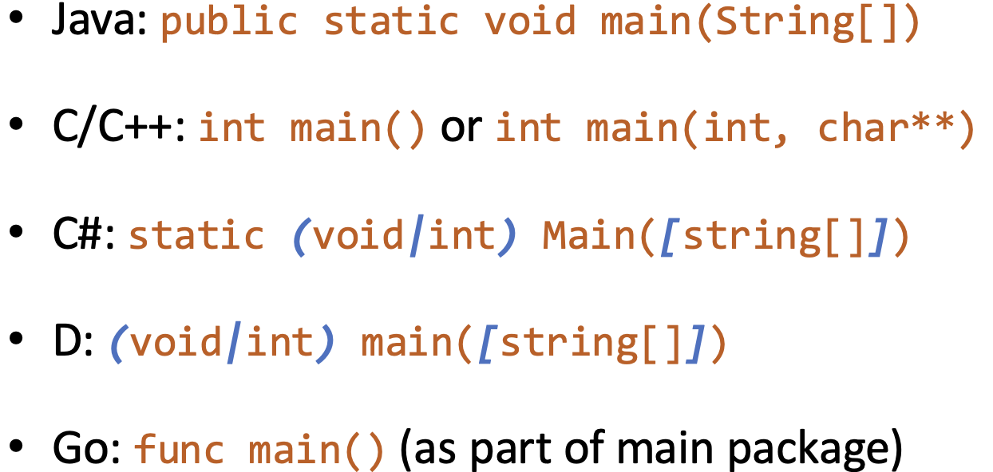
Every program has exactly one entry point
Typically called main
May be evaluated in order of appearance
Compiled F# program: use [<EntryPoint>] to show entry point
Python: check if __name__ == "__main__"
Notes:
F# script mode will execute code from top to bottom
Python: run file directly (execute code from top to bottom)
imported as a module, then you don’t what code be executed when run “import xxx”
__name__ == “__main__” is to run file directly

Slide 9
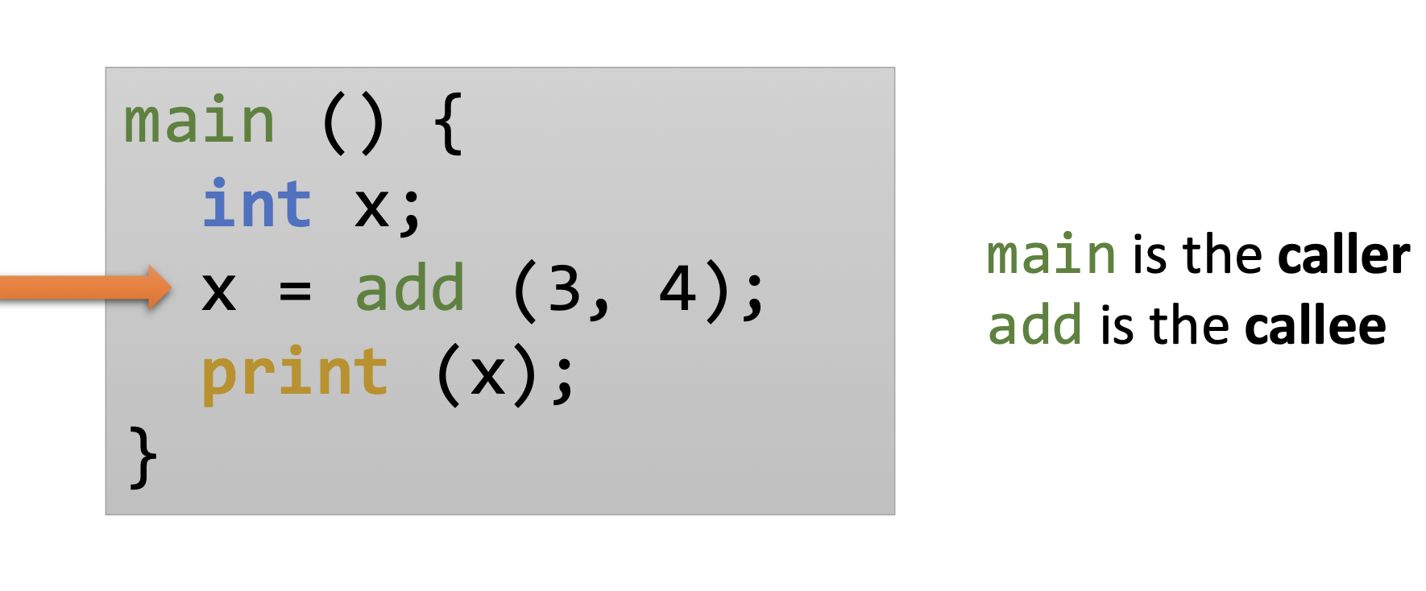
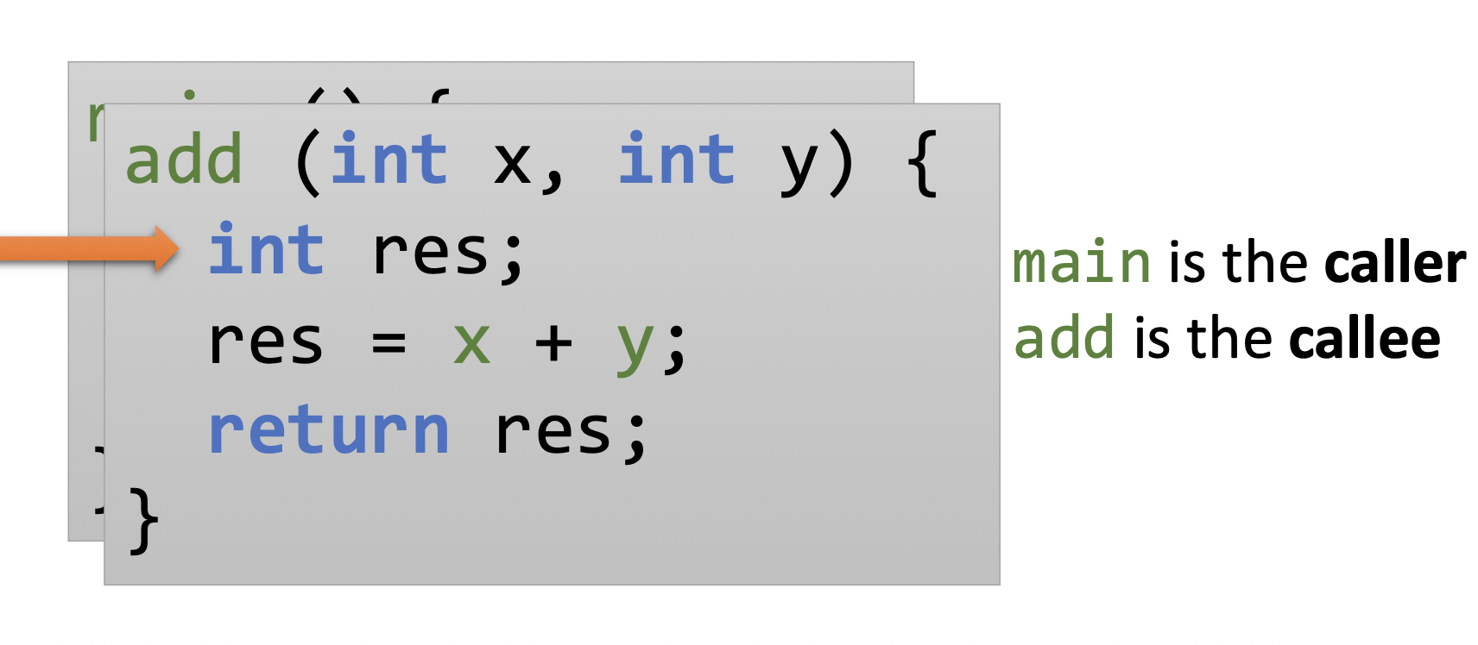
A calling subprogram (caller) is suspended during the execution of the called subprogram (callee)

Slide 10
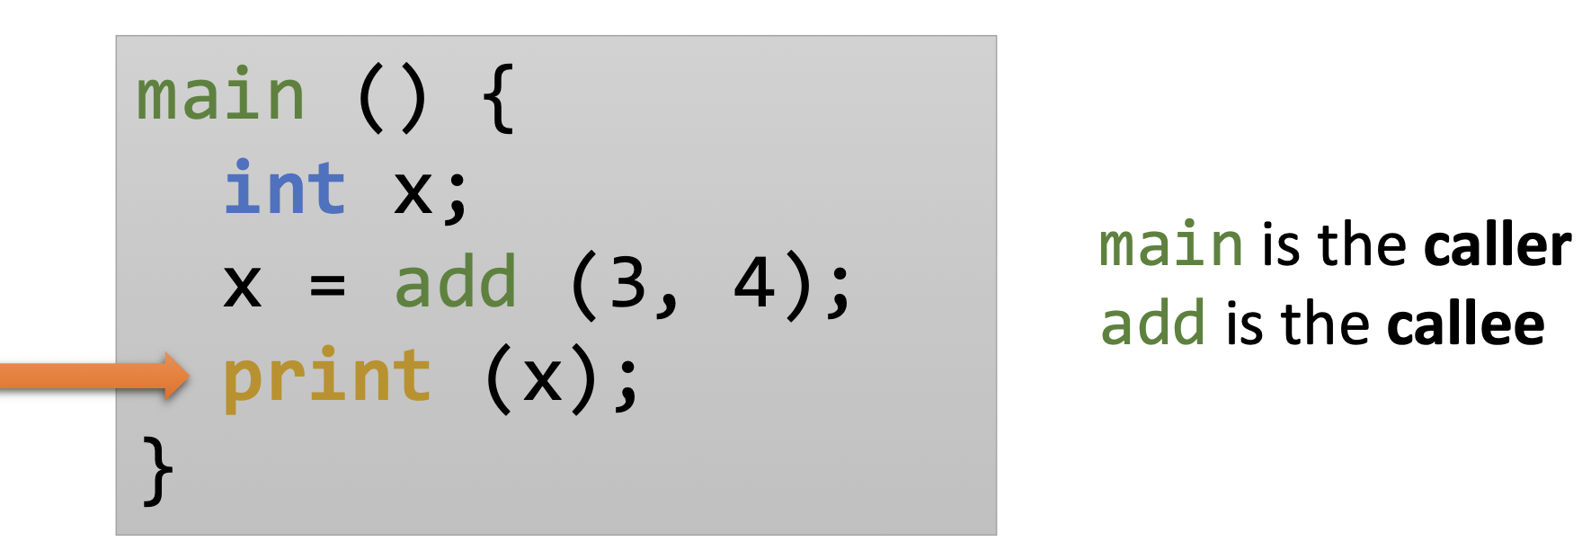
Control will always return to the caller when the callee terminates

Slide 11
Activation Record
What do we need to keep track of in order to implement subprogram execution abstraction?
Point subprogram will (eventually) return to (return address)
Parameters
Local variables
An activation record is the data structure that stores all information needed to execute a subprogram call
Notes:
F
F
T
T
T (hint, no termination, so false -> anything is true)

Slide 12
Activation Record
Return Address
Location in the program to continue after the subprogram finishes
Stored in the callee’s activation record
Dynamic Link (Control Link)
Pointer to the caller’s activation record; stored in the callee’s activation record
Used to restore the previous stack frame on return
Parameters
Data explicitly passed from caller to callee
Local Variables
Data created within the callee
Includes all blocks (statically determined)
Notes:
Return Address Tells the CPU where to continue in the code
Used to resume execution after the call
Dynamic Link Tells the runtime which stack frame to go back to
Used to restore the caller’s environment (stack frame)

Slide 13
Activation Record: Caller Semantics
Return Address
Save on stack
Parameters
Evaluate arguments and pass to callee

Slide 14
Activation Record: Callee Semantics
Dynamic Link
Save pointer to caller’s activation record
Parameters
read values during execution
Local Variables
make space for all local variables (subtract from %rsp, register that holds the address of the top of the stack)

Slide 15
Activation Record: Return Semantics
Return Address
Return execution to statement following call
Dynamic Link
Restore caller’s activation record
Parameters
Update reference parameters during execution
Local Variables
Deallocate created space (add to %rsp)
Notes:
Try: {wlp?} x=x*x +10 {x is a prime}
Solution: x*x + 10 is a prime

Slide 16
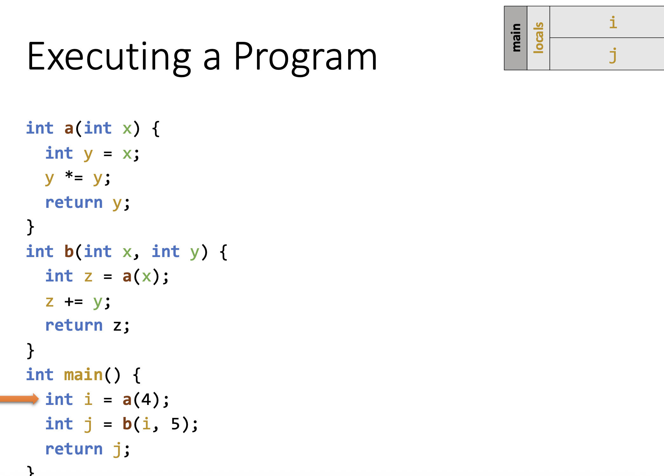
Example

Slide 17
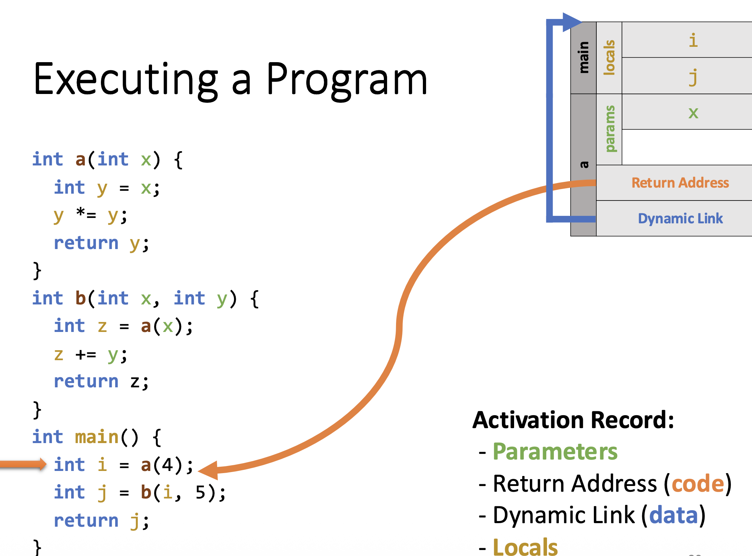

Slide 18
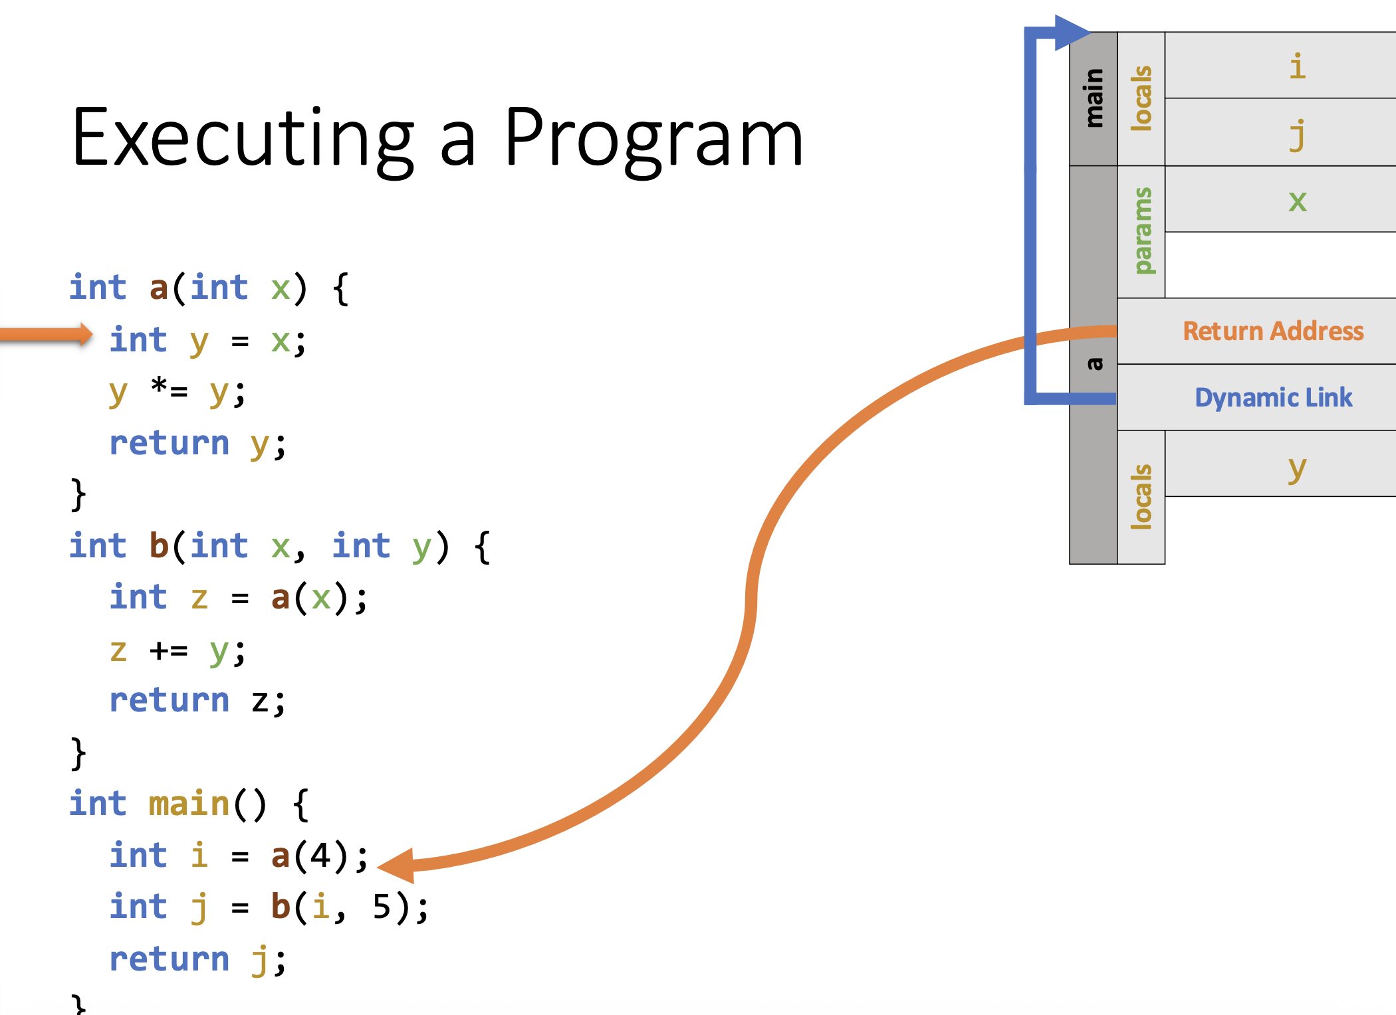
Notes:
Dynamic Link: It means “who is my caller in the stack”

Slide 19
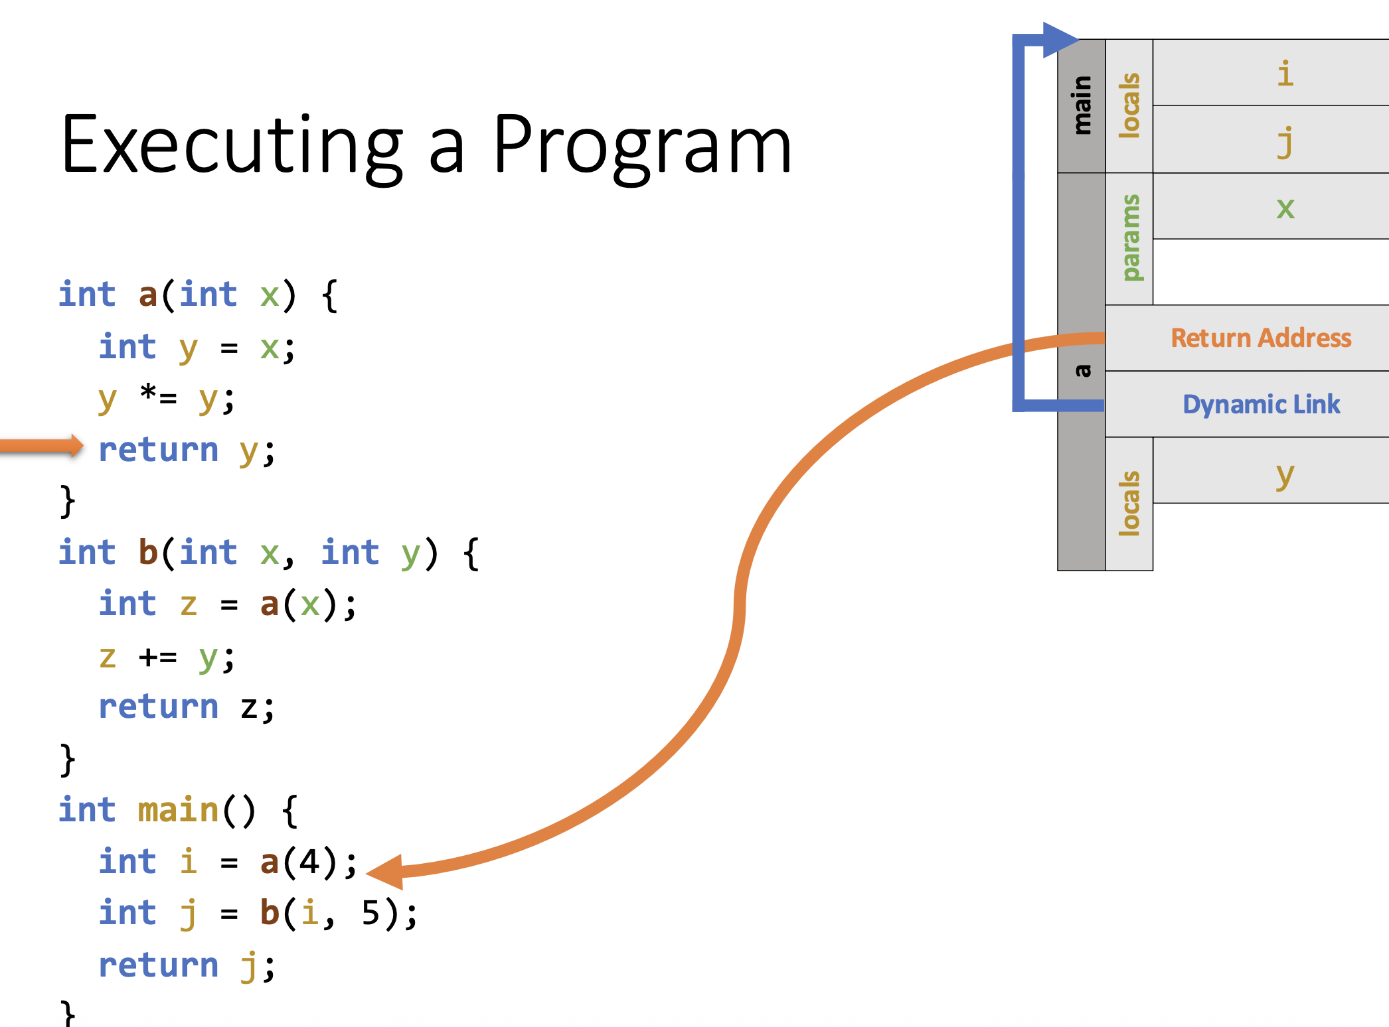

Slide 20
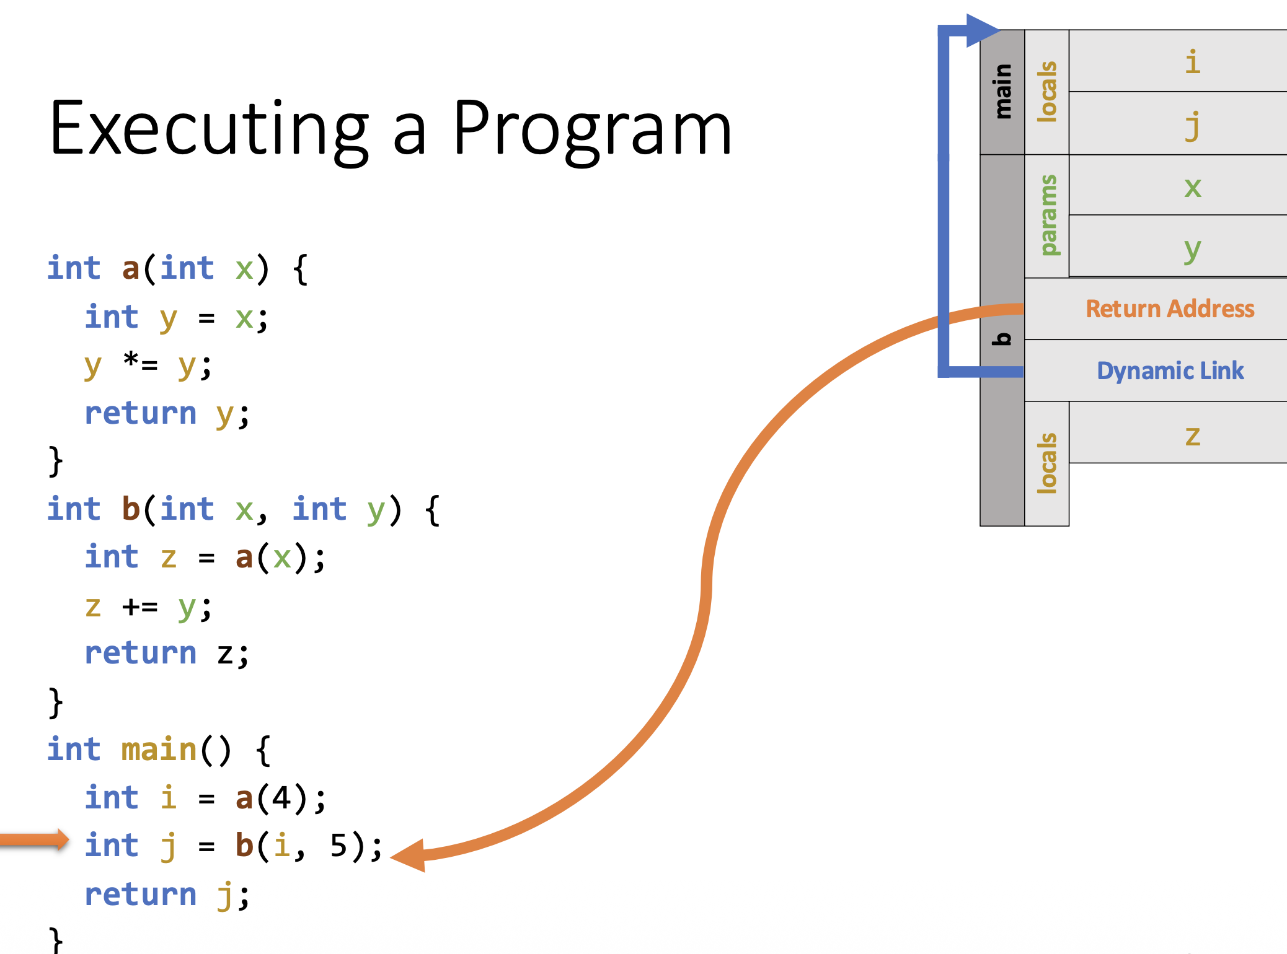

Slide 21
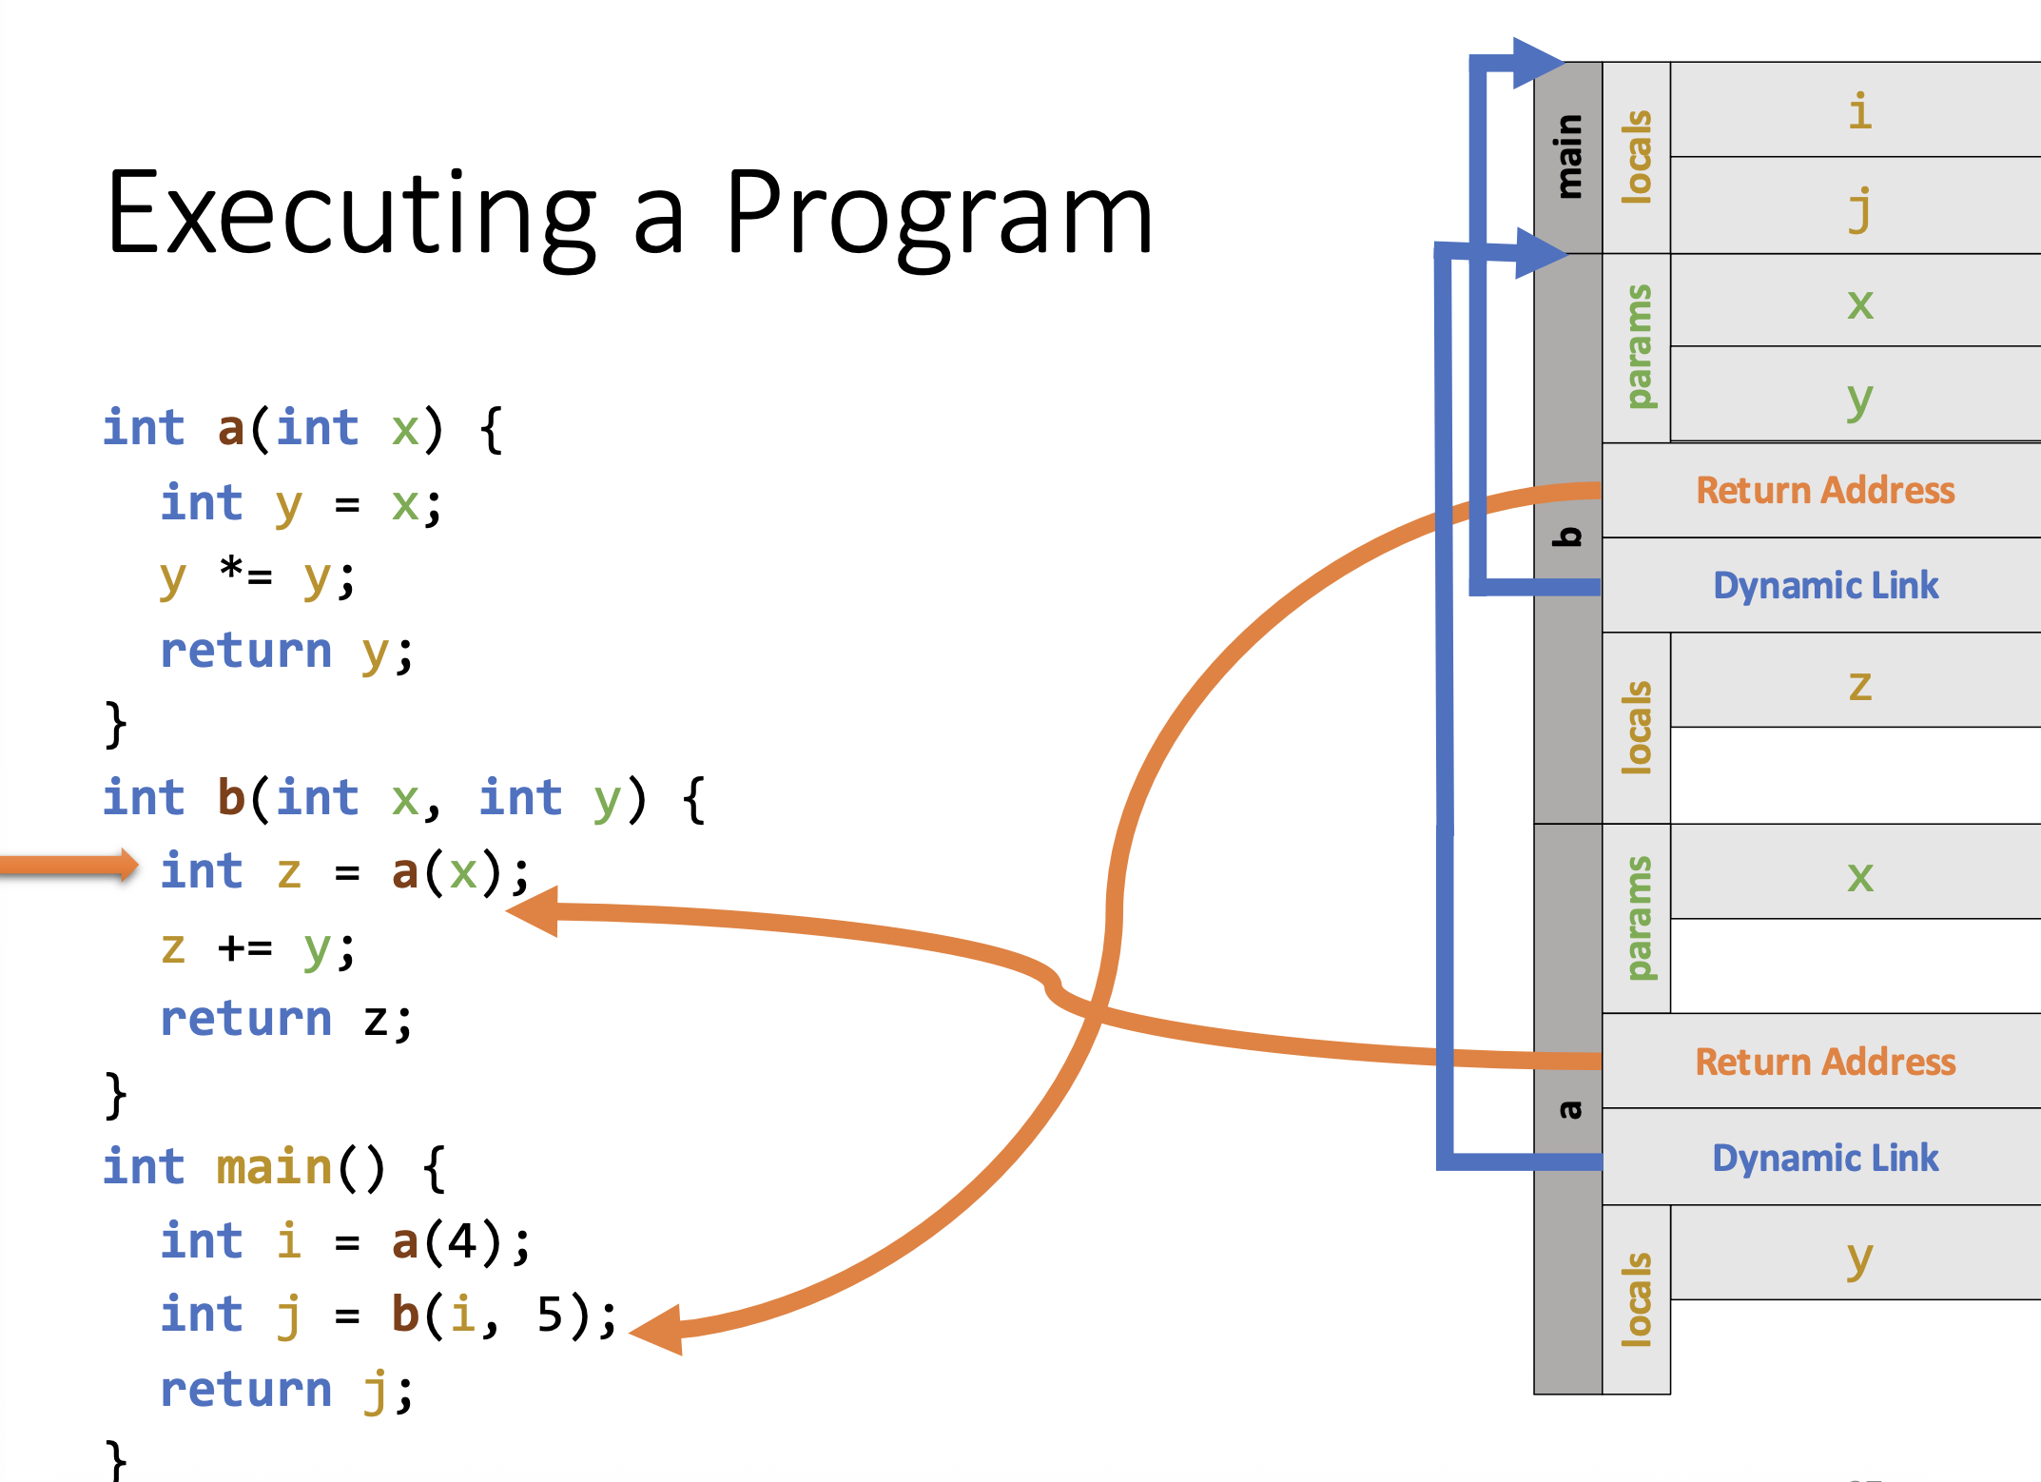

Slide 22
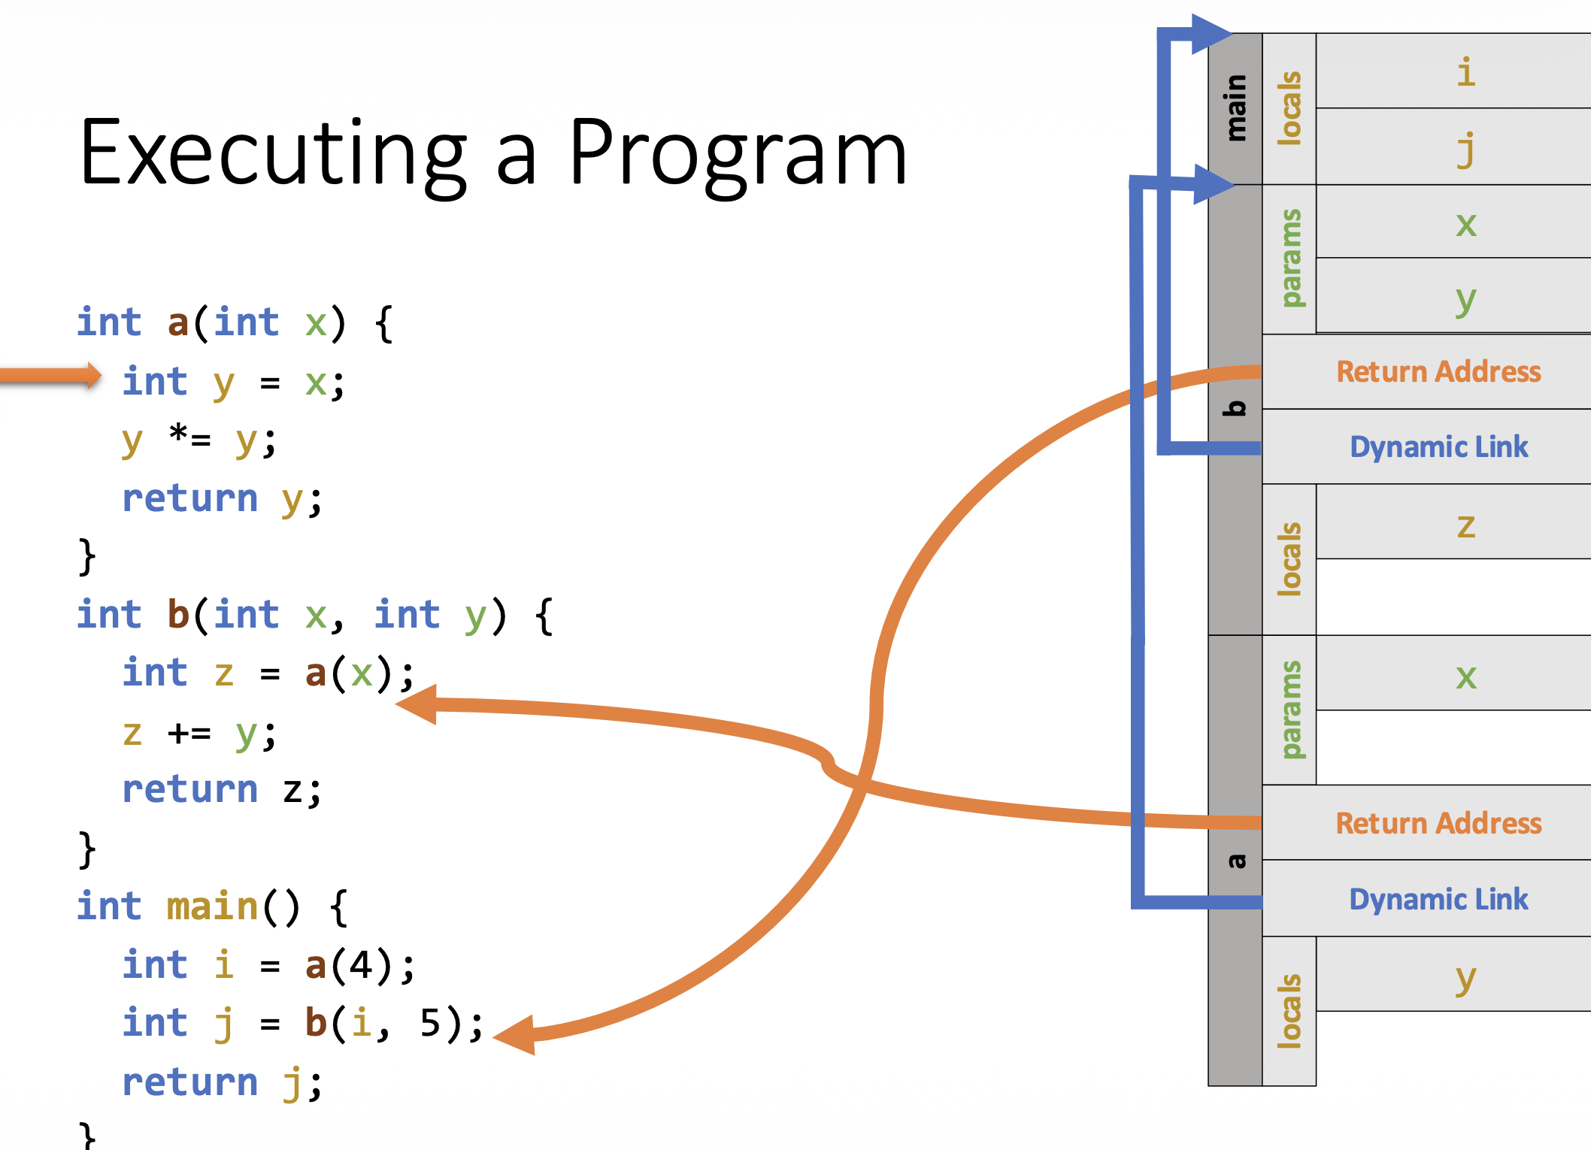

Slide 23
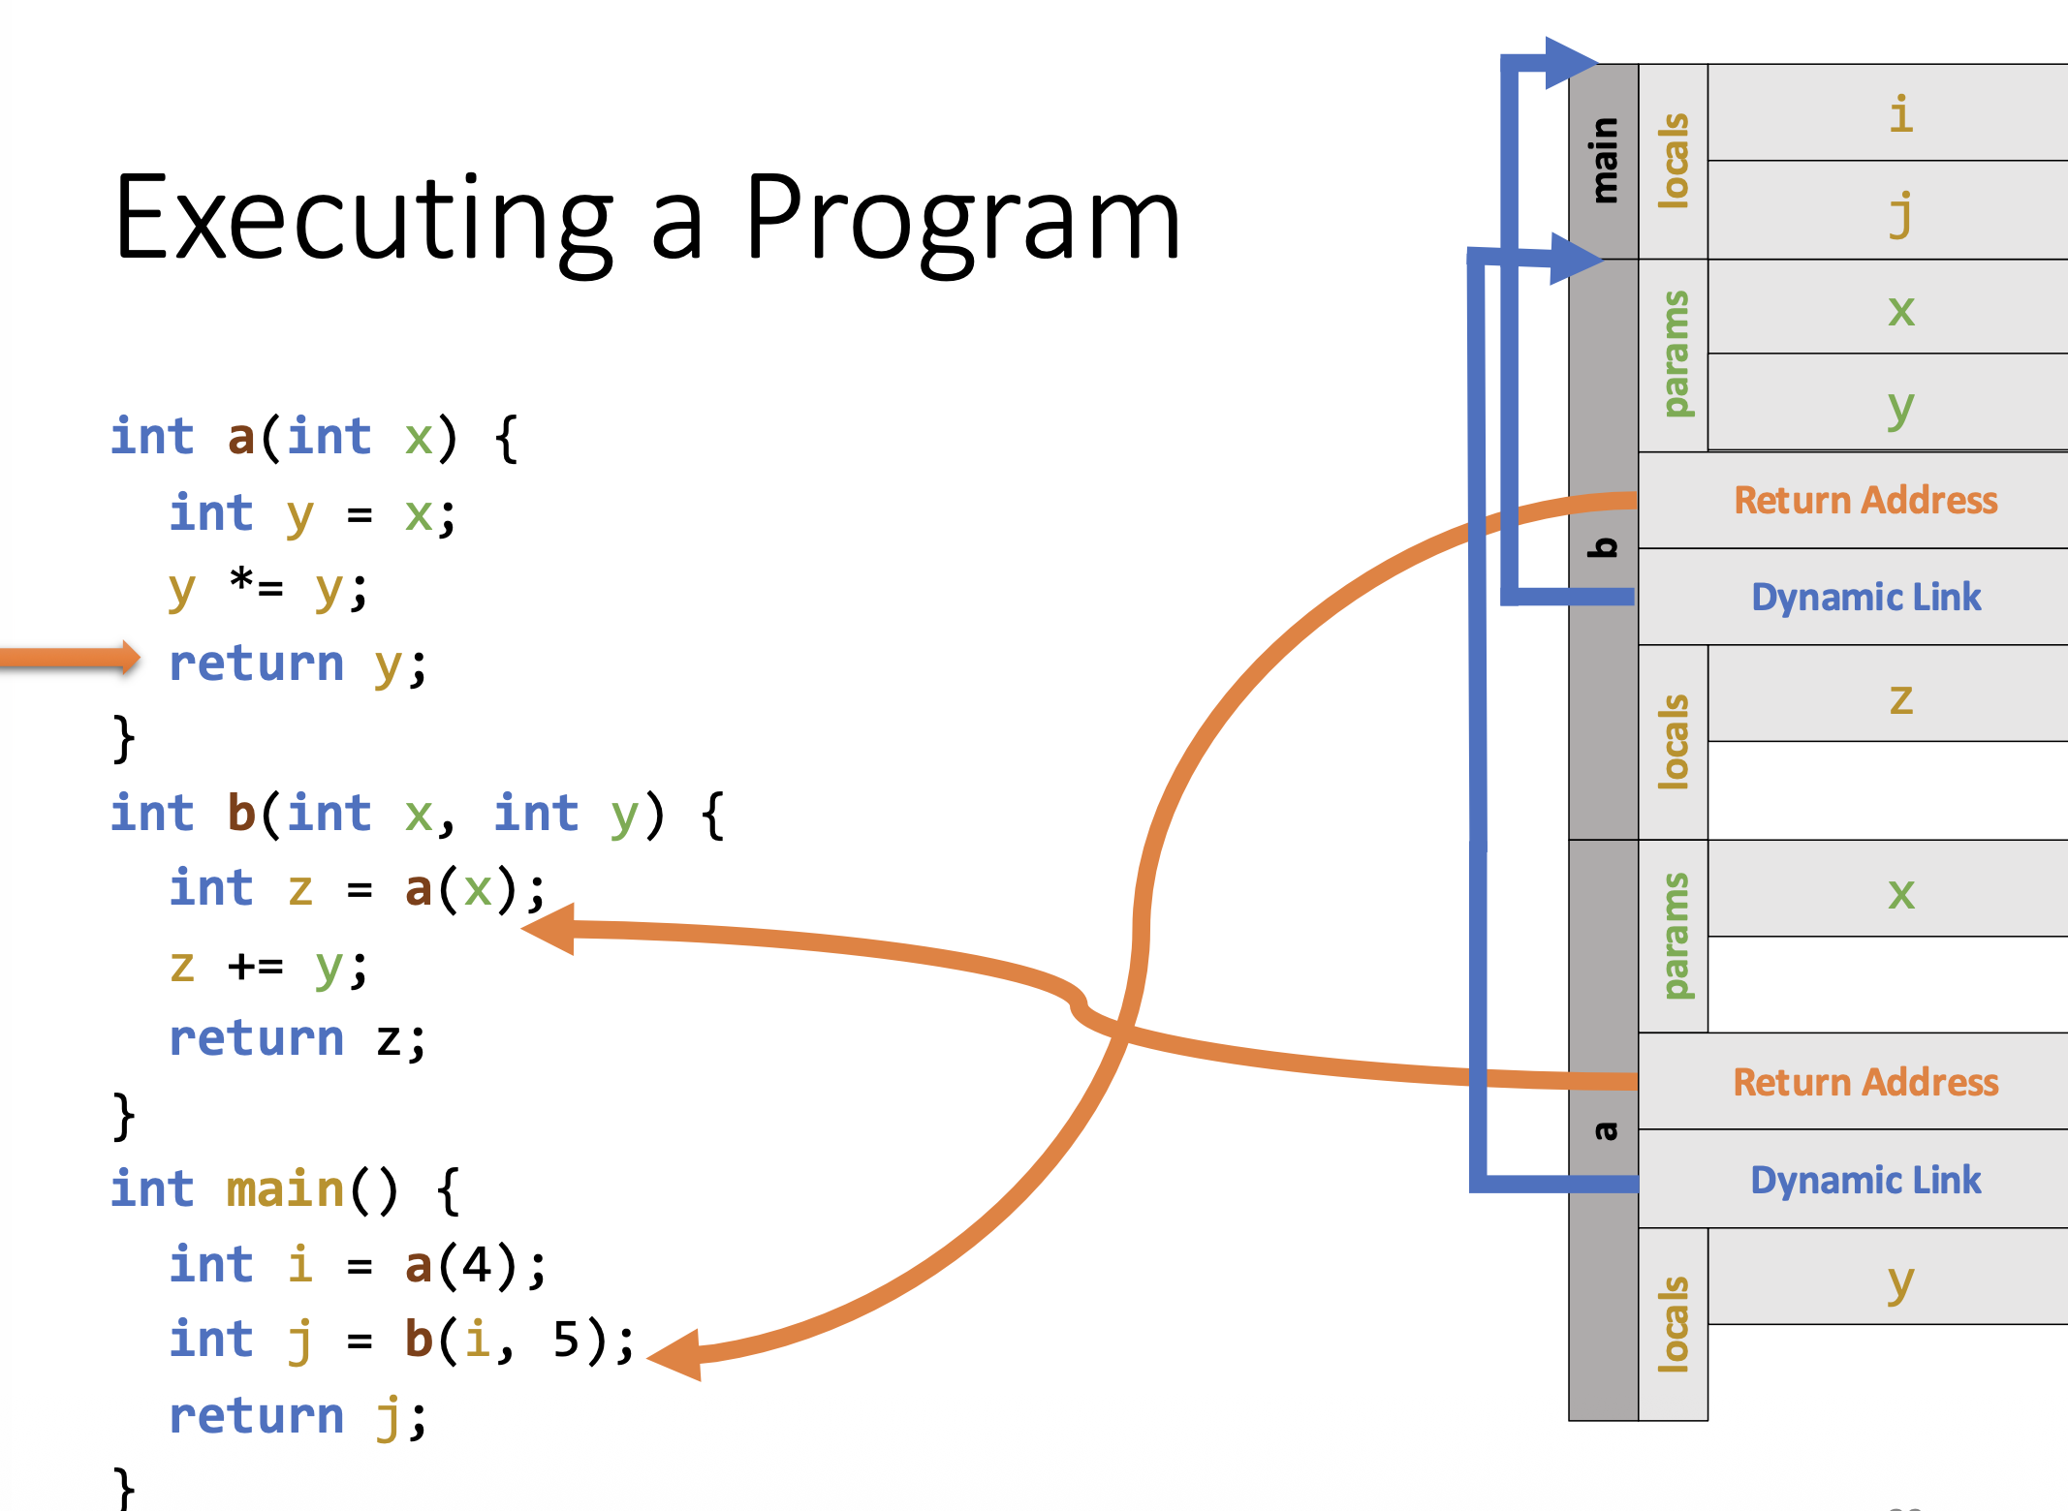

Slide 24
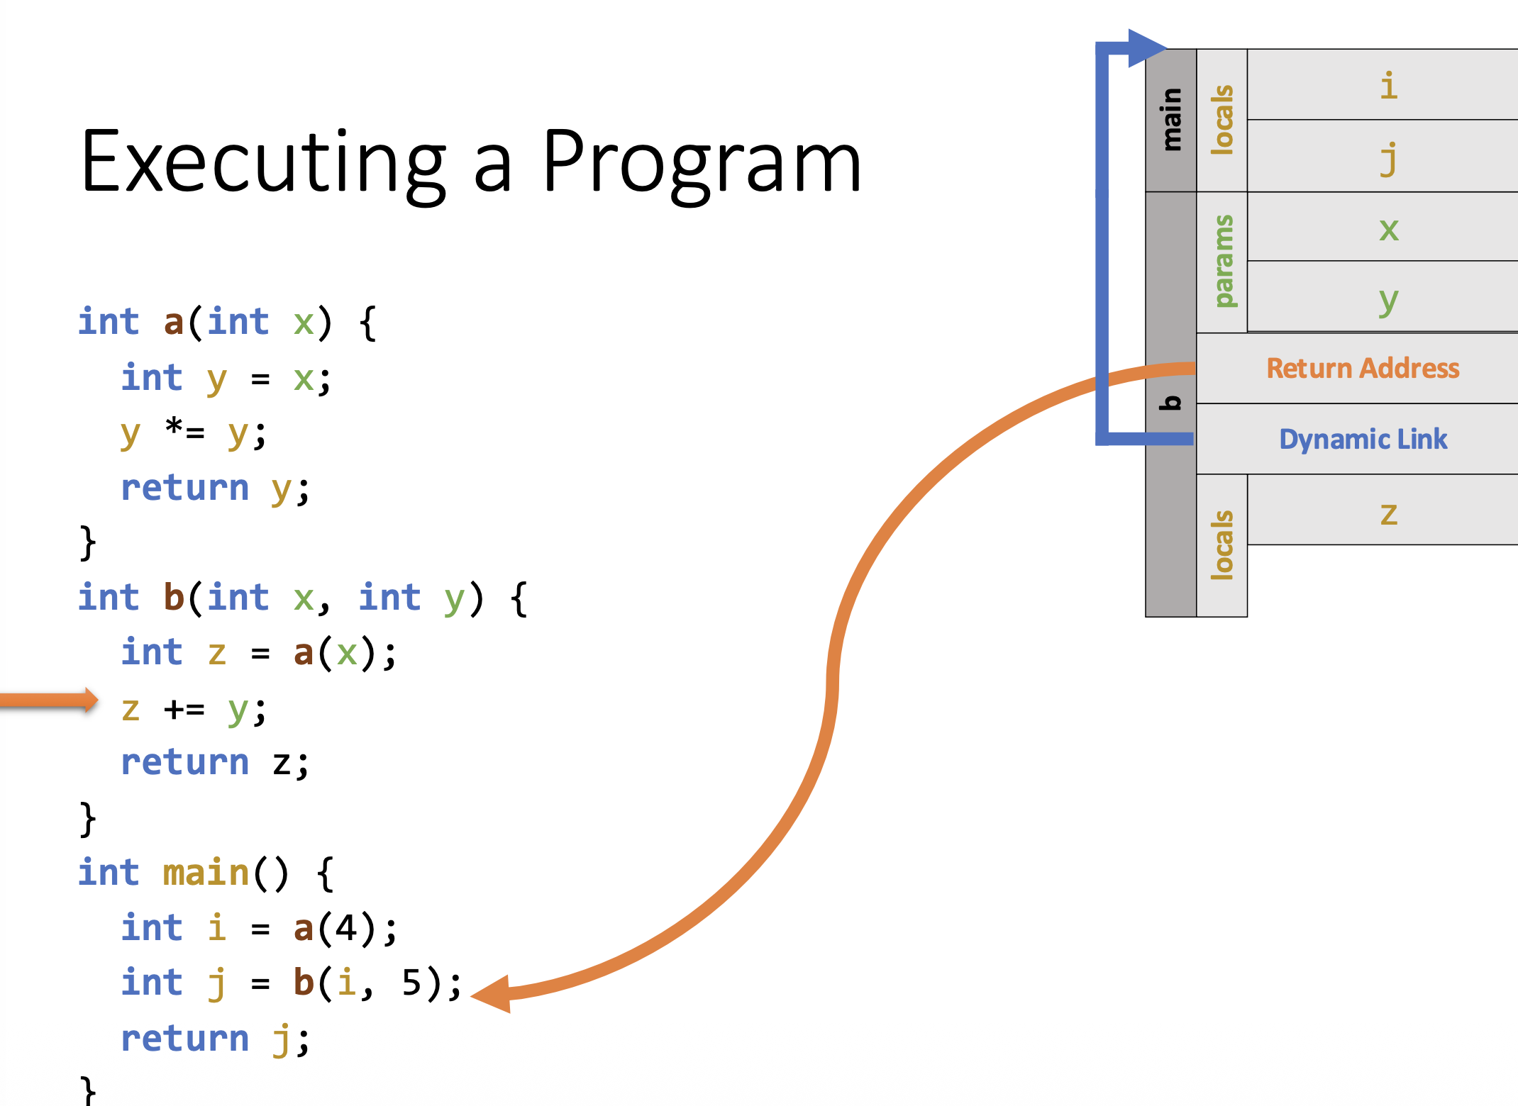

Slide 25
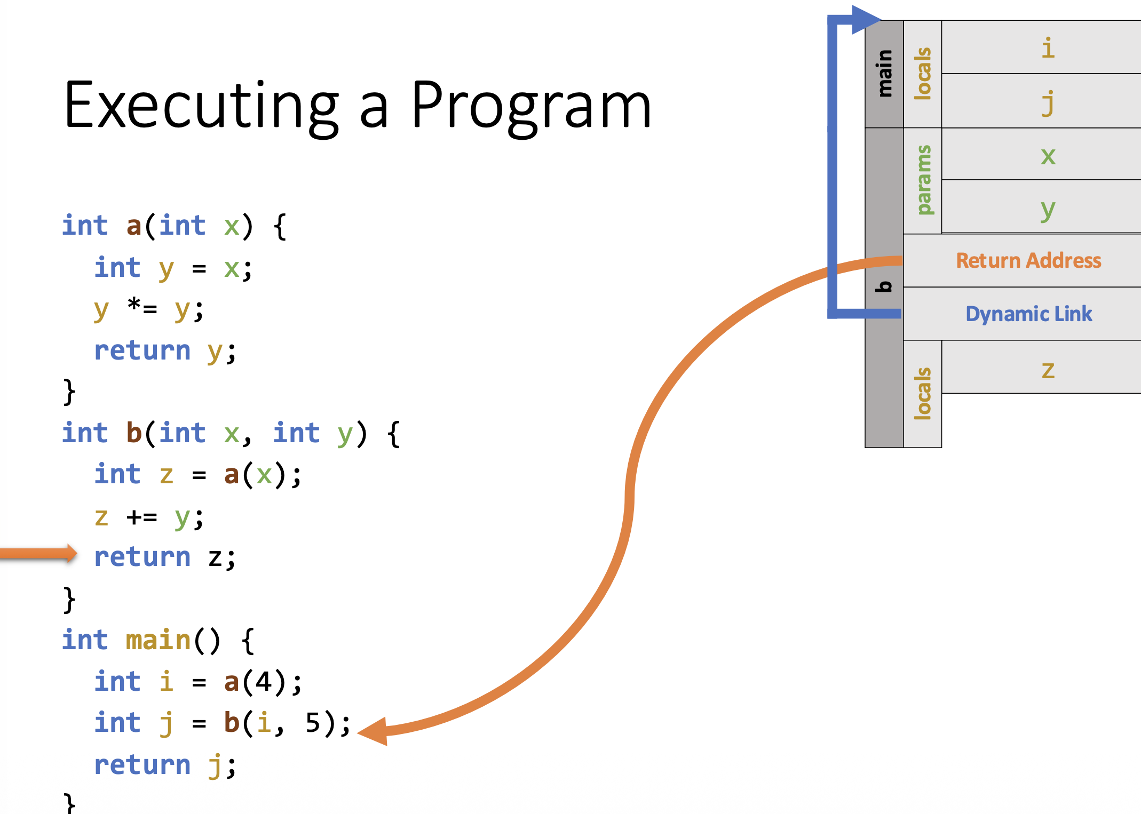

Slide 26
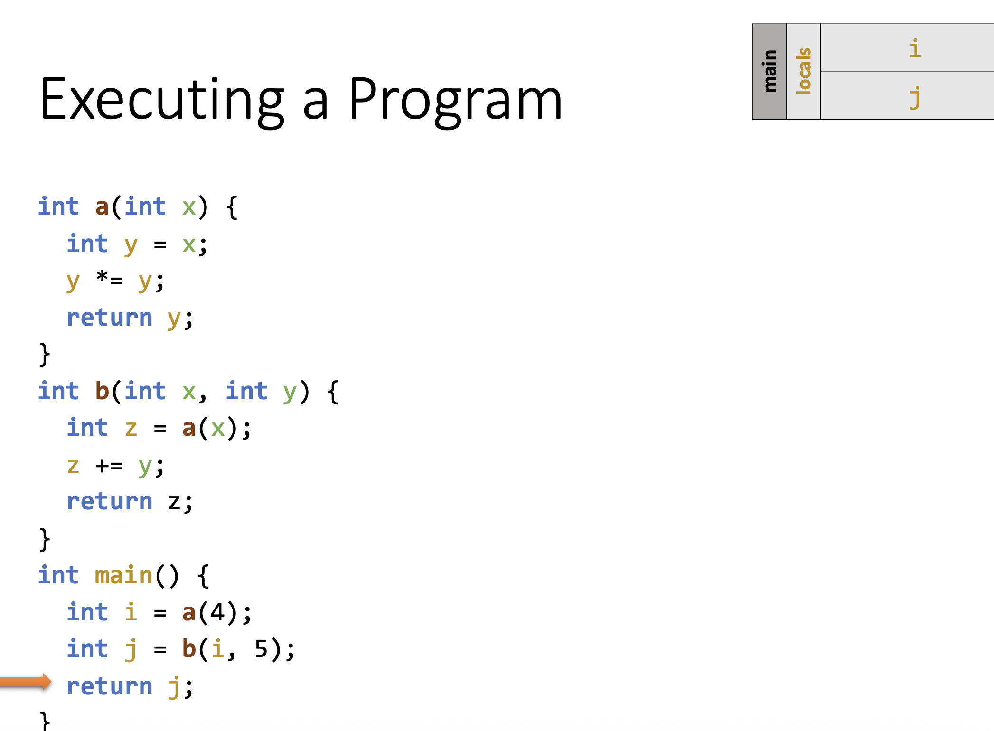

Slide 27
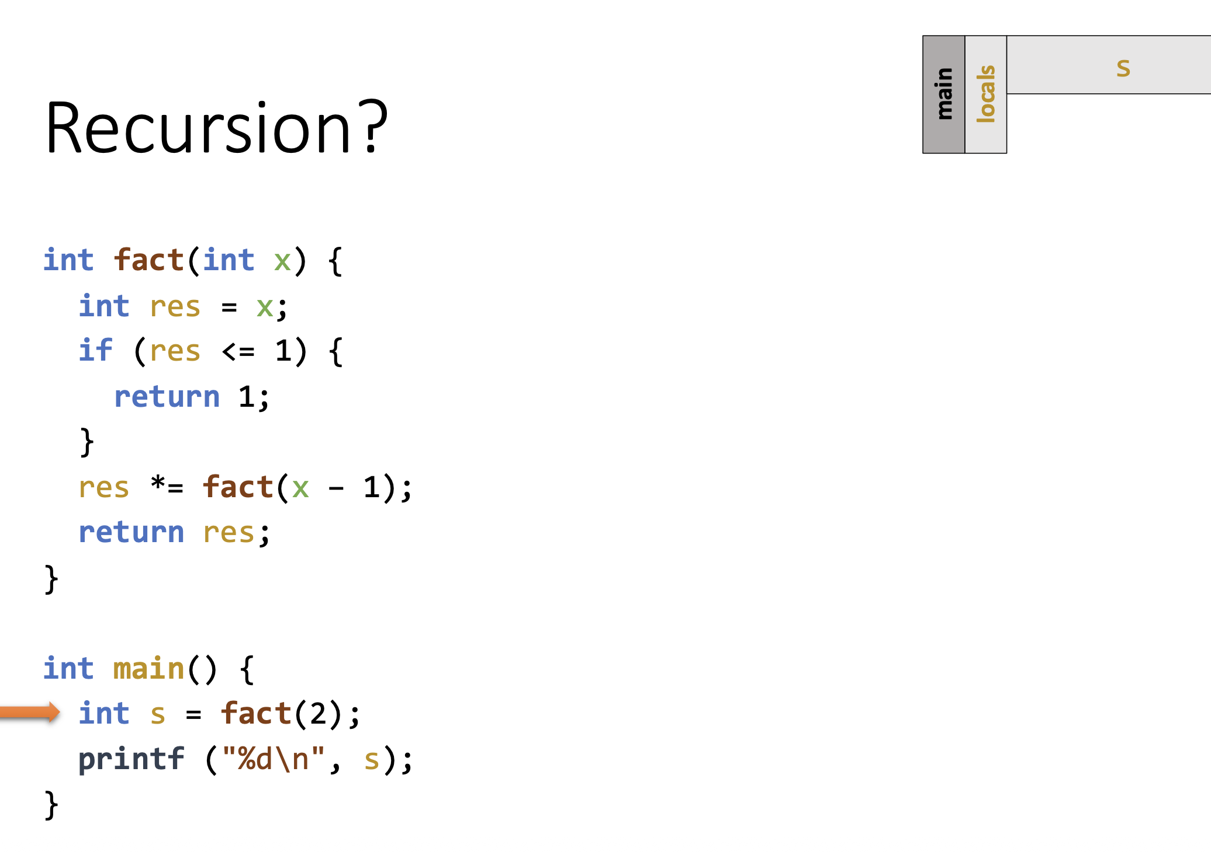
Recursive Example

Slide 28
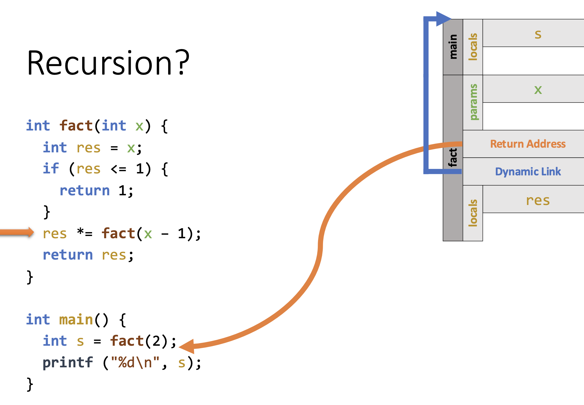

Slide 29
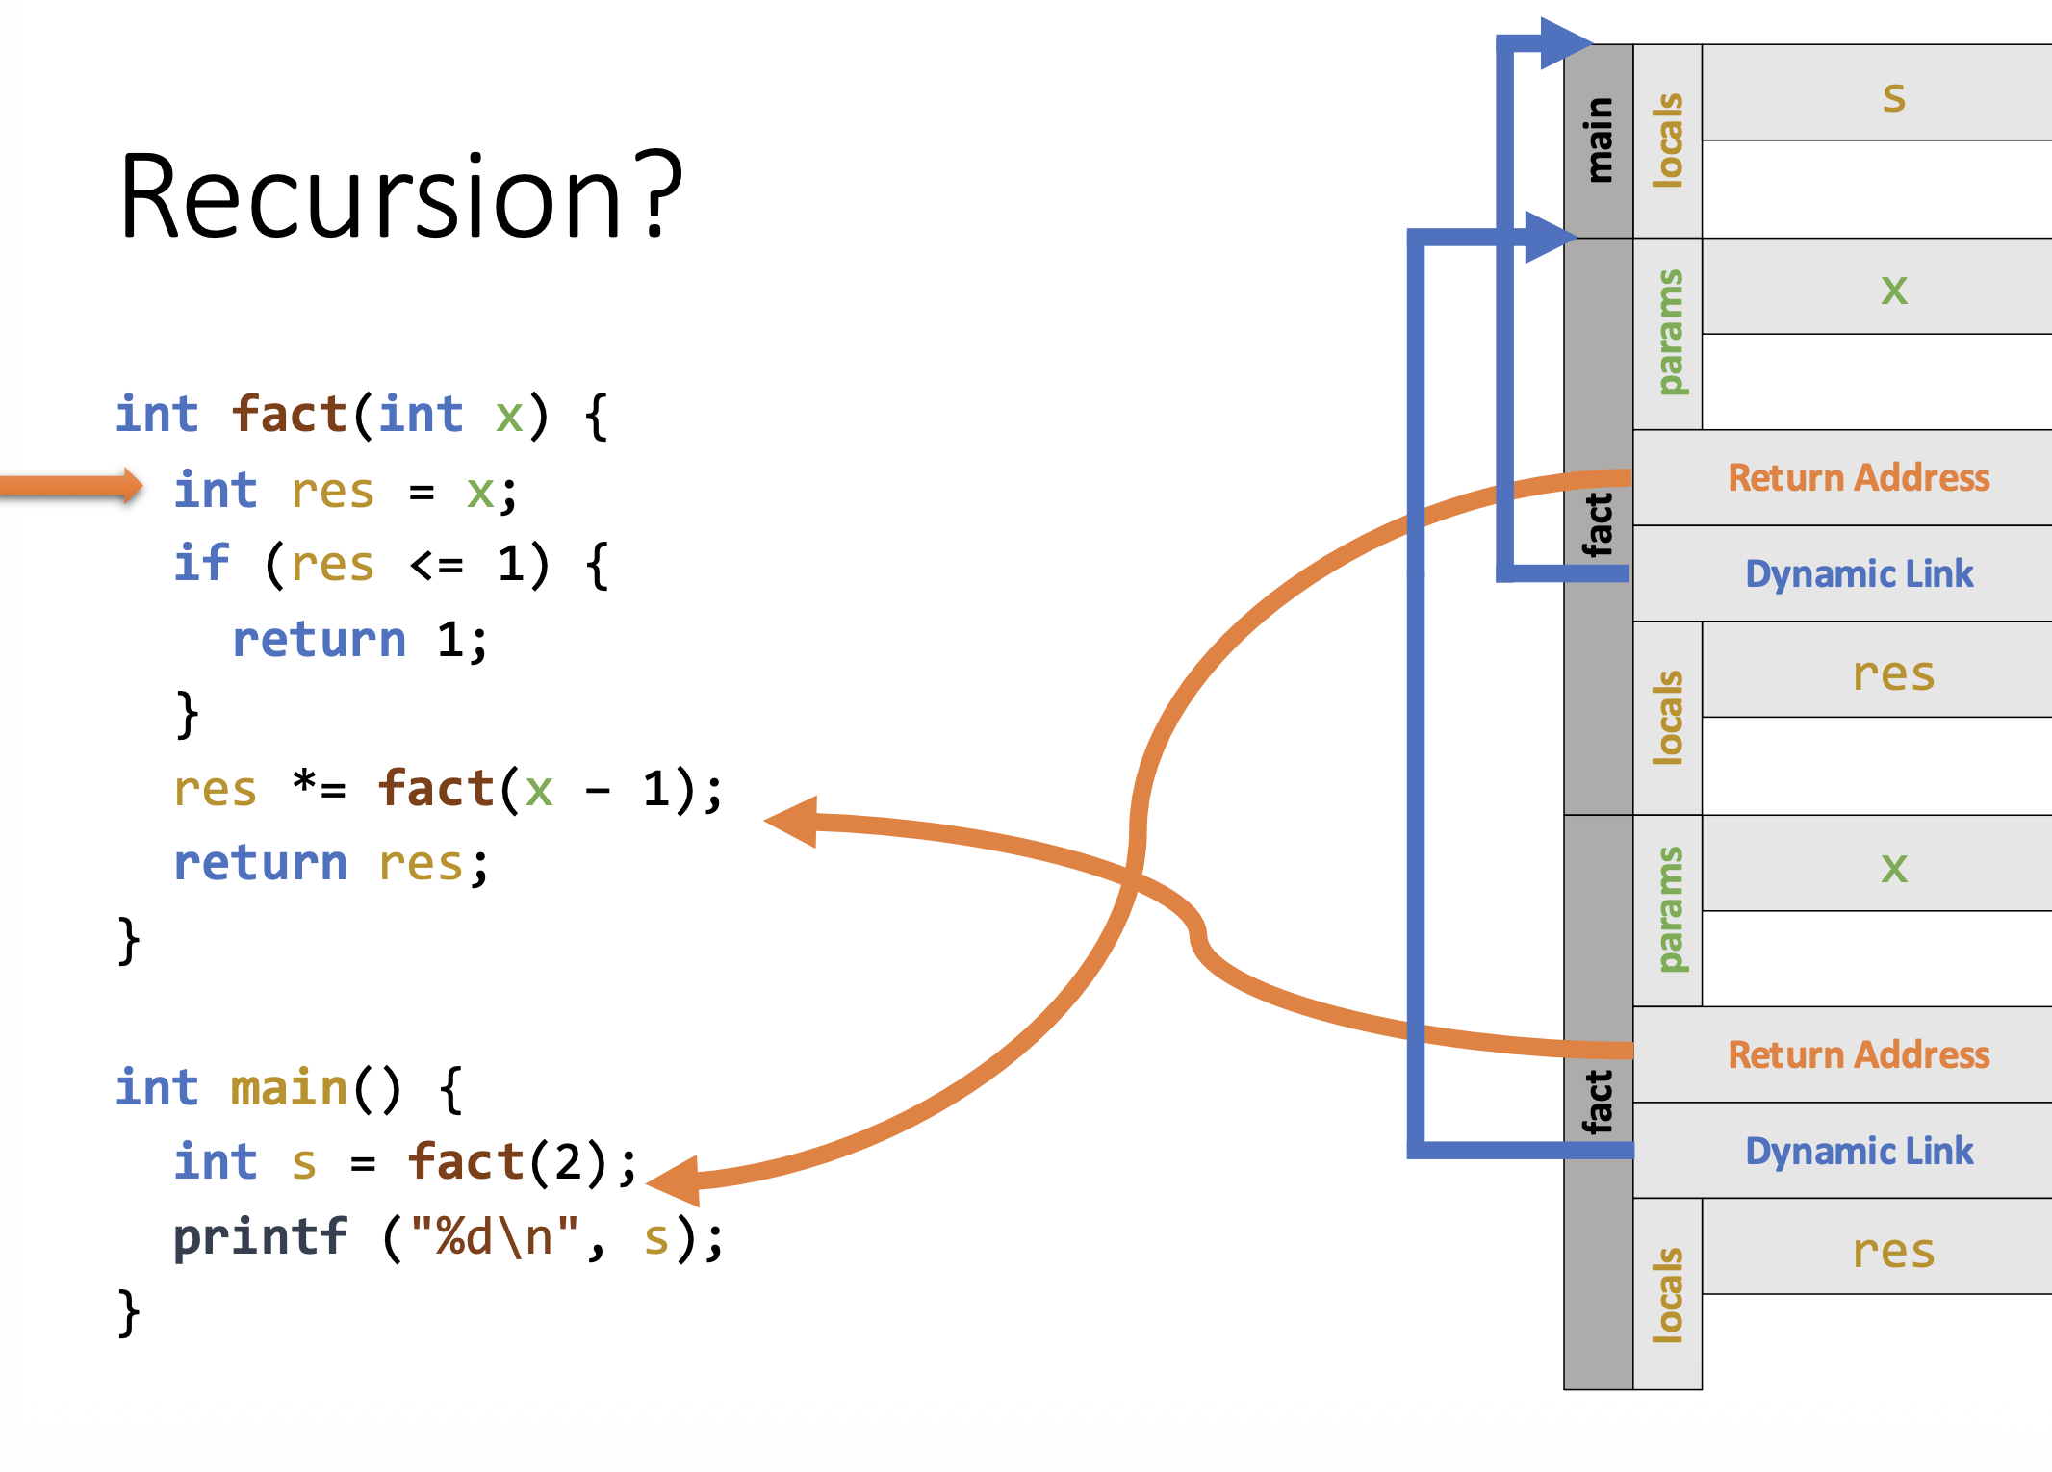

Slide 30
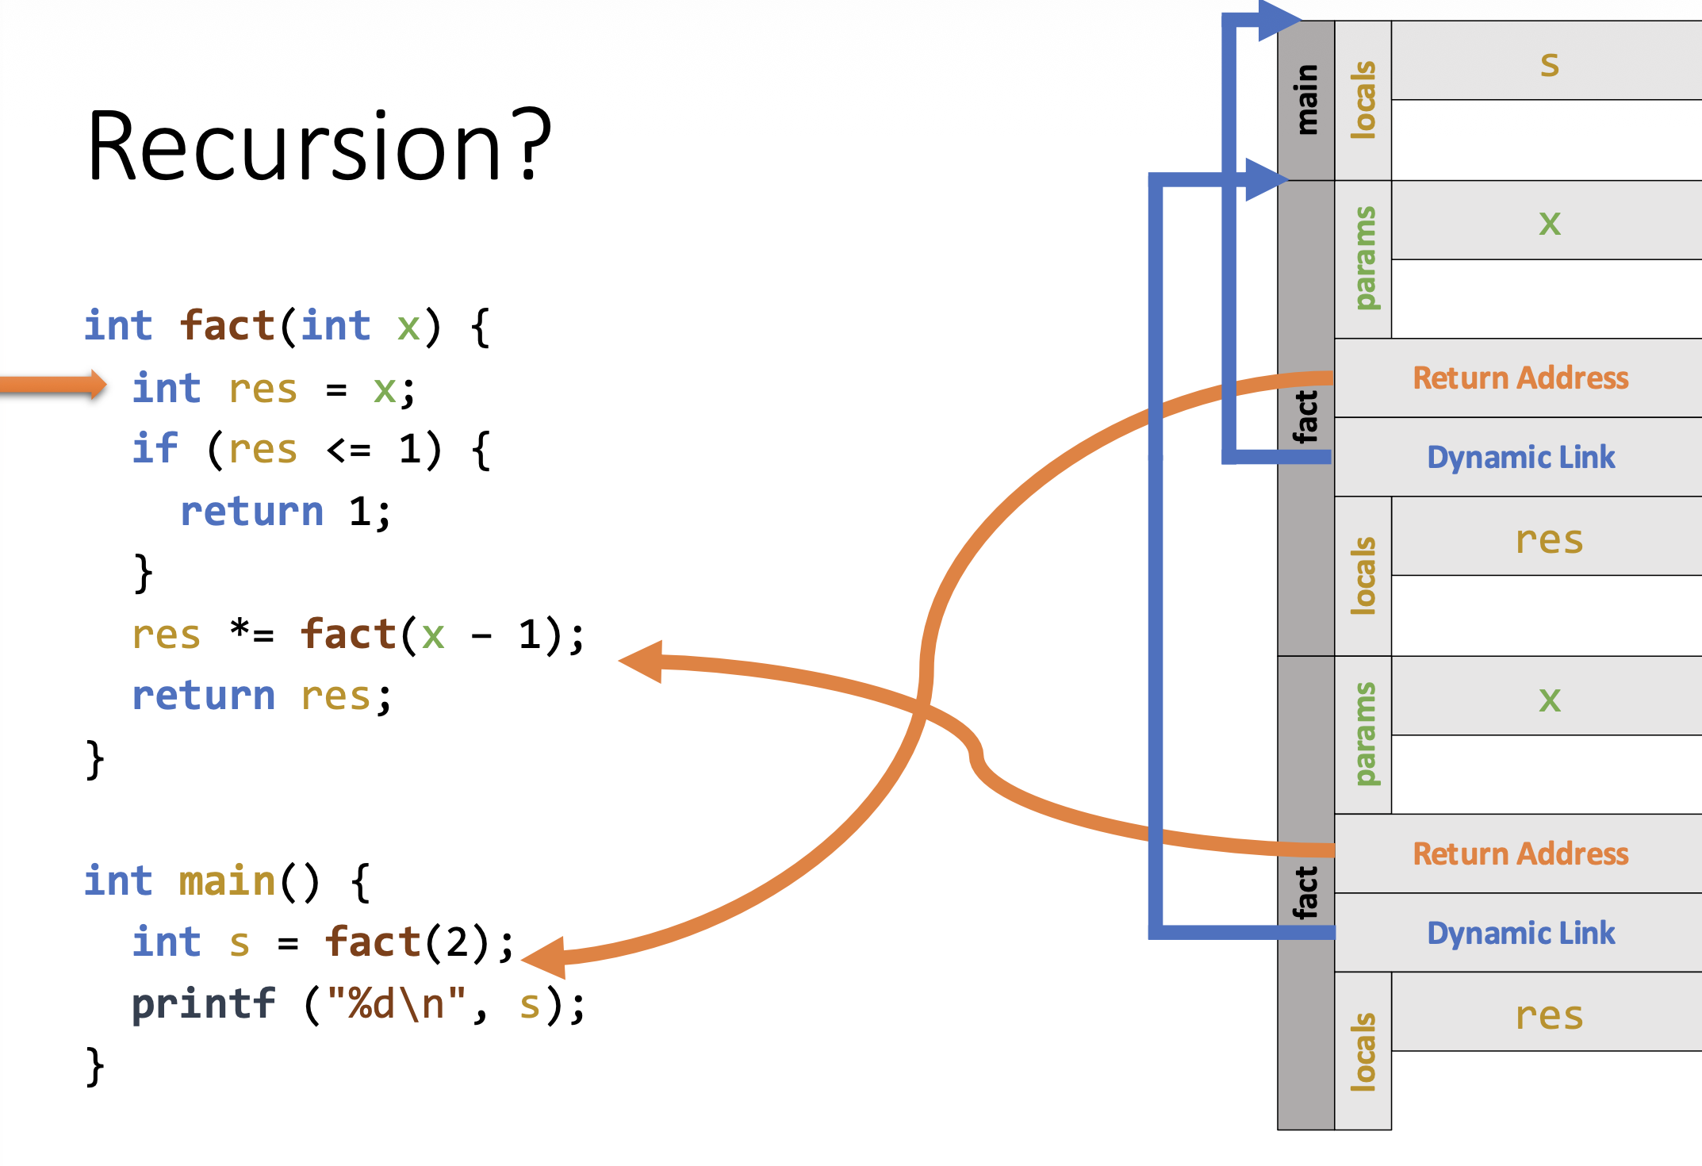

Slide 31
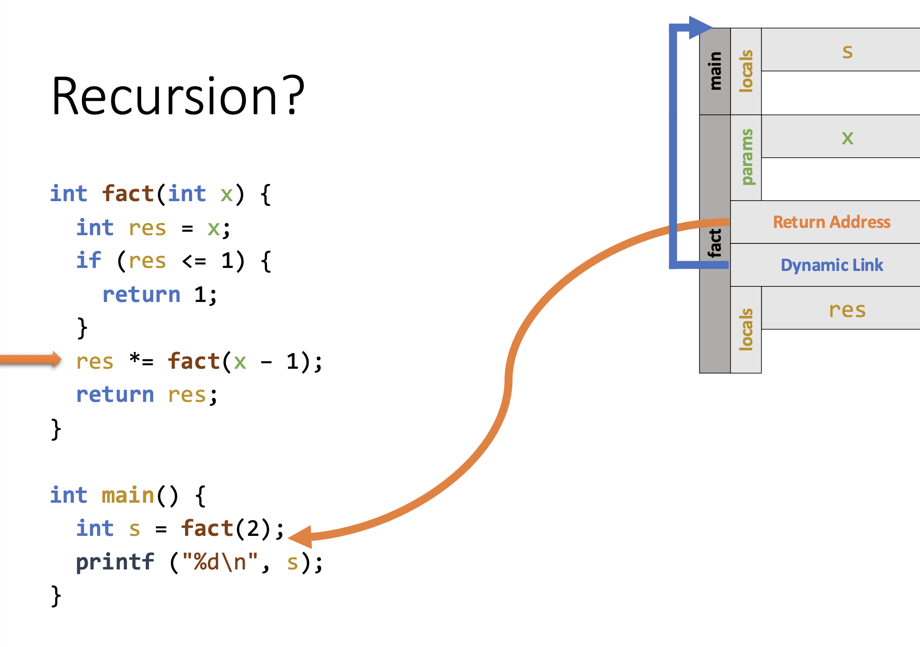

Slide 32
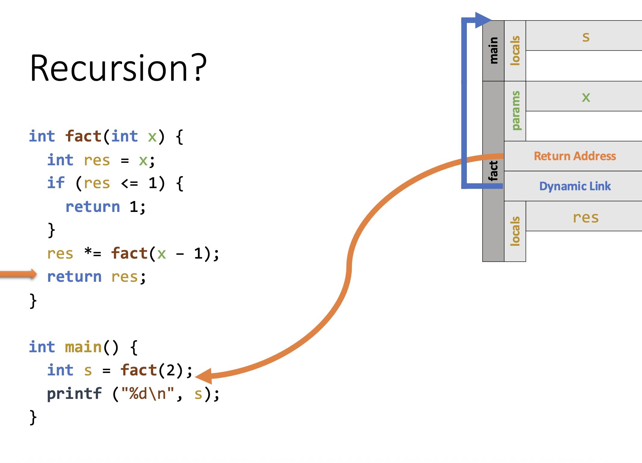

Slide 33
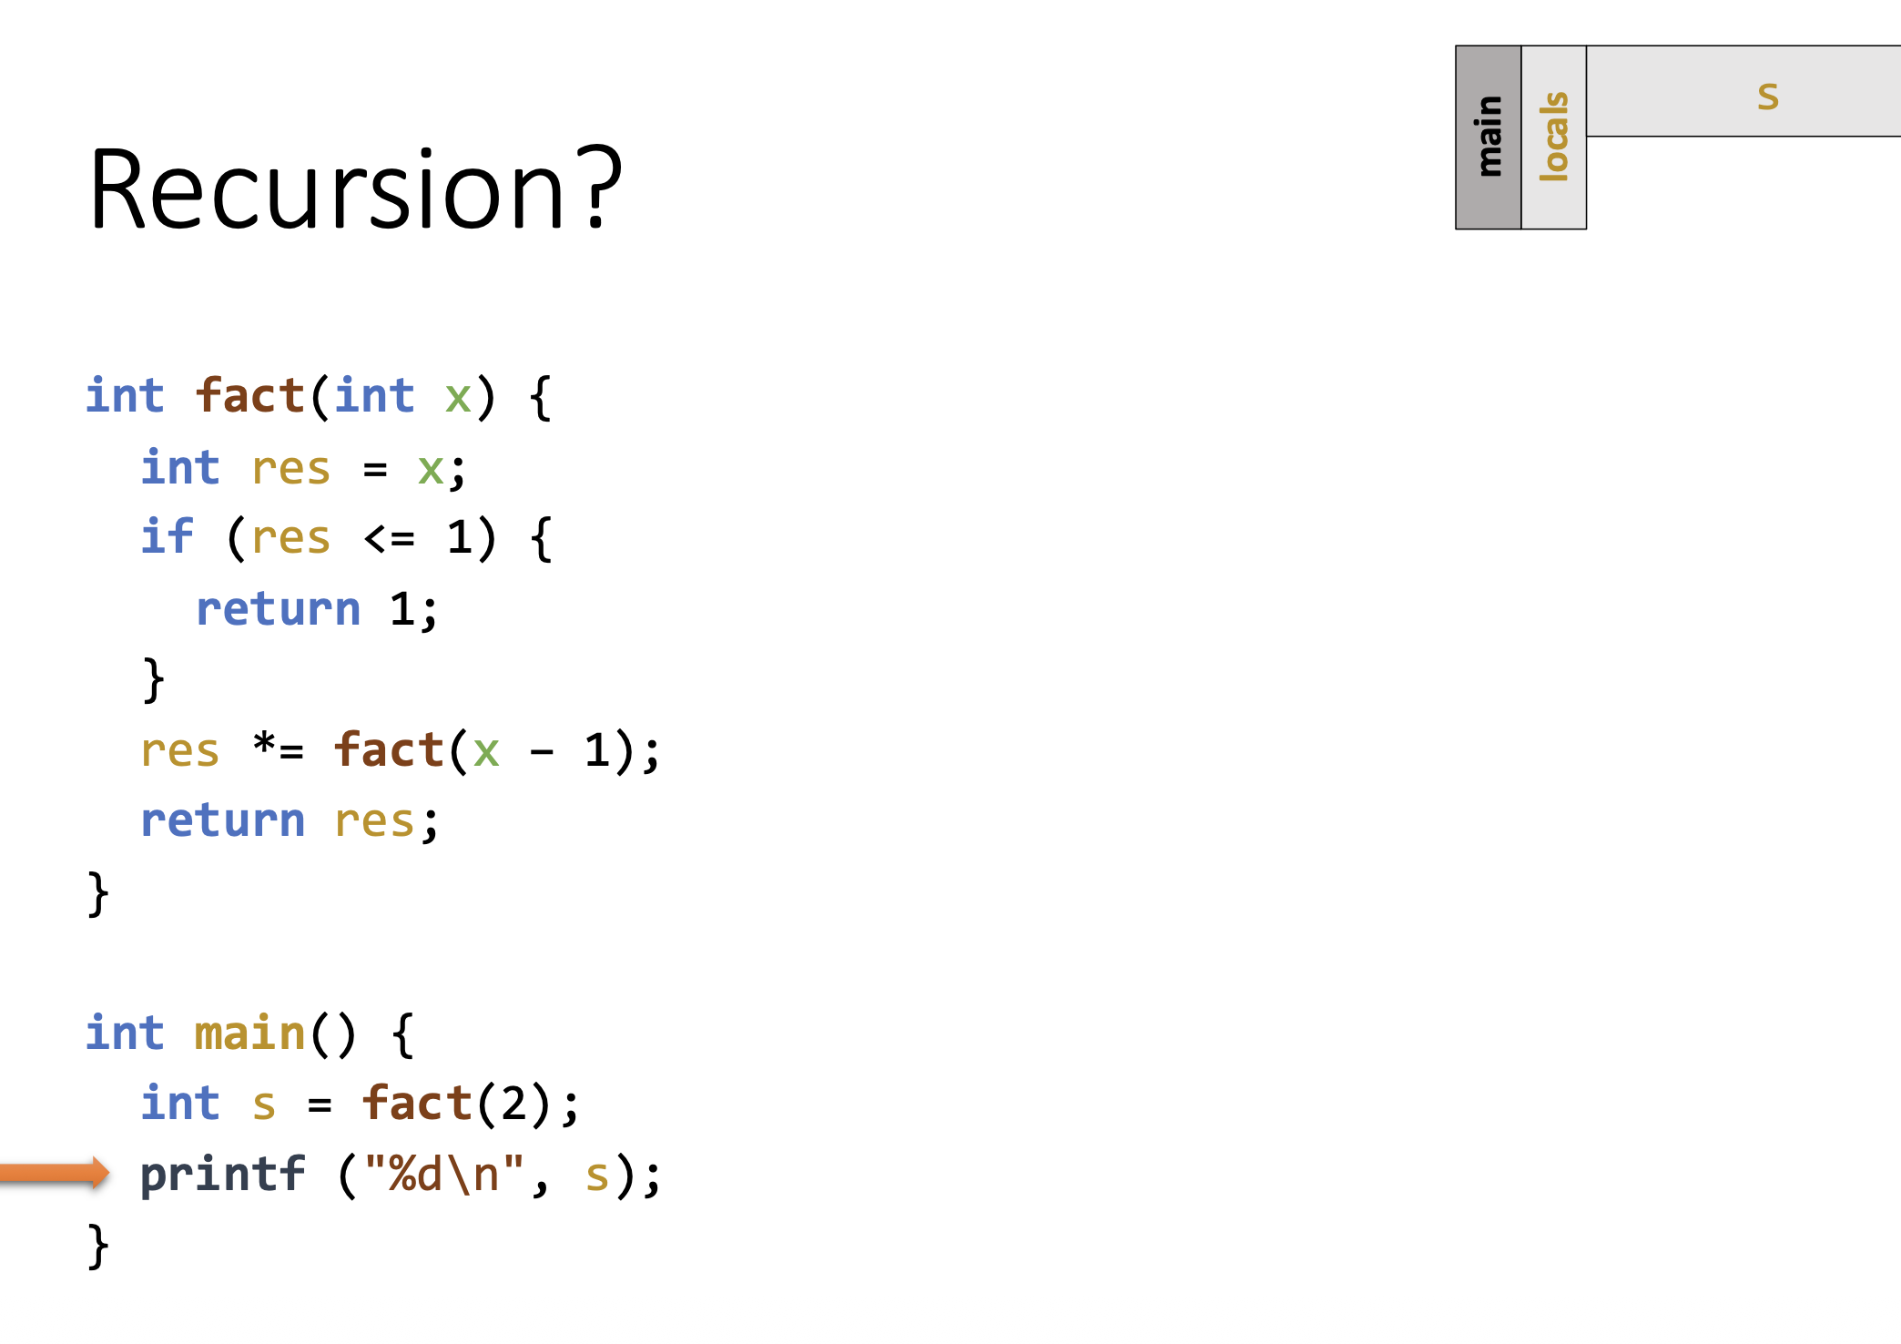

Slide 34
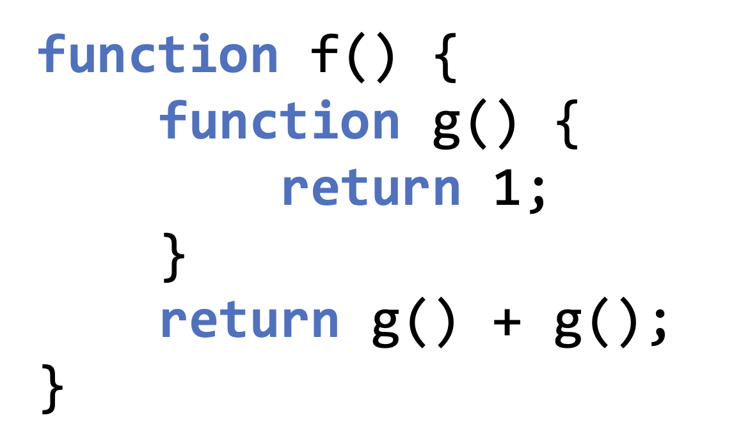
Nested Subprograms
A subprogram is considered nested when it is defined within another subprogram

Slide 35
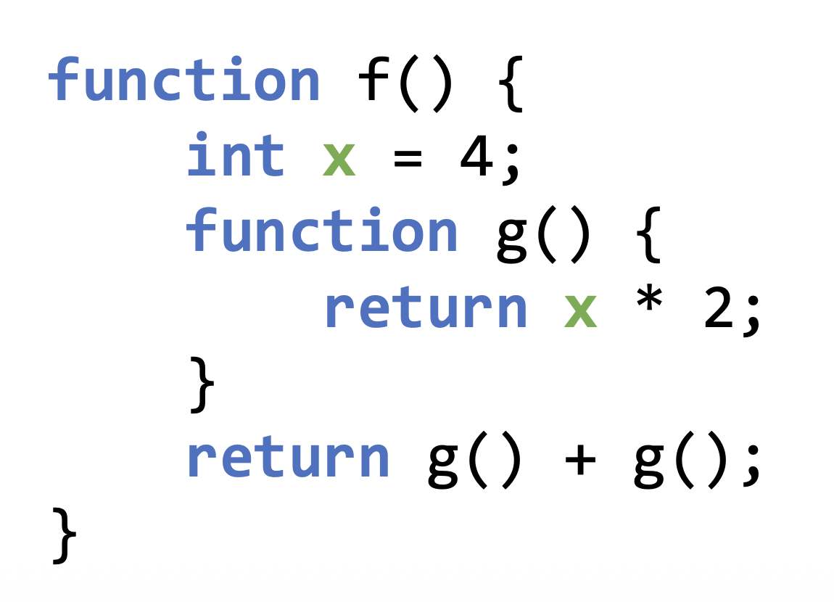
Nested Subprograms: Issues
Non-local references must be resolved
E.g.,

Slide 36
Resolving a Non-Local Reference
When a function uses a non-local variable, the runtime does two things:
Step 1: Find the correct activation record (stack frame)
Under dynamic scope → follow the call stack (most recent first)
Under static scope → follow the static links (lexical nesting)
Step 2: Find the variable inside that activation record
Determine the correct variable offset within the selected activation record instance
Notes:
Once you know which function’s frame
You already know where the variable sits in memory
Example:
int a; // offset 0 int b; // offset 4 int c; // offset 8
Compiler knows this → just jump to the offset

Slide 37
Two Approaches to Non-Local Reference Resolution
1. Static Scoping
Create and manage a static chain.
The static chain is a list of static ancestors.
2. Dynamic Scoping
Deep Access: Scan the dynamic link chain
Shallow Access: Maintain a central “stack” of names to references

Slide 38
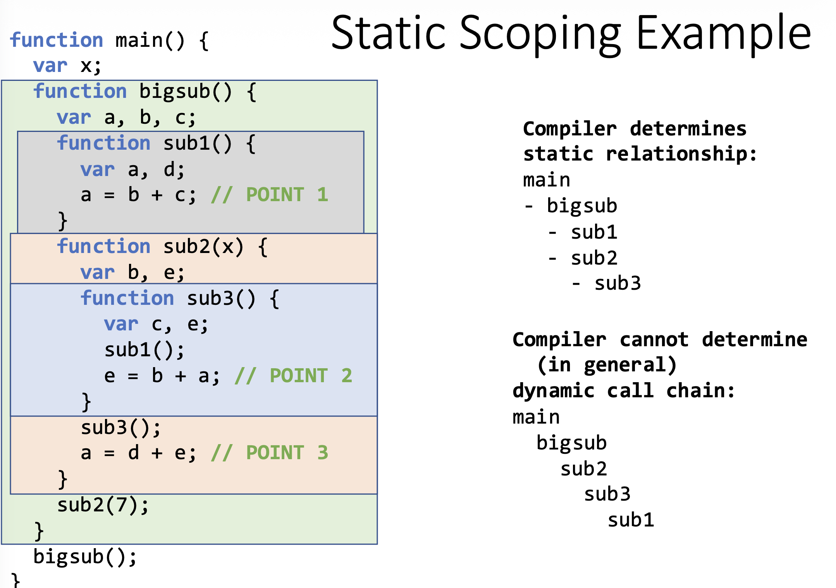

Slide 39
Static Scoping
At a function call the activation record needs to include an additional piece of information: static link
The static link will refer to the most recent activation record of the static parent
Problems:
Non-local references are slow when the nesting depth is large
Cost of non-local references is difficult/impossible to determine
Simple code changes can alter/change the nesting depth (which changes the performance)

Slide 40
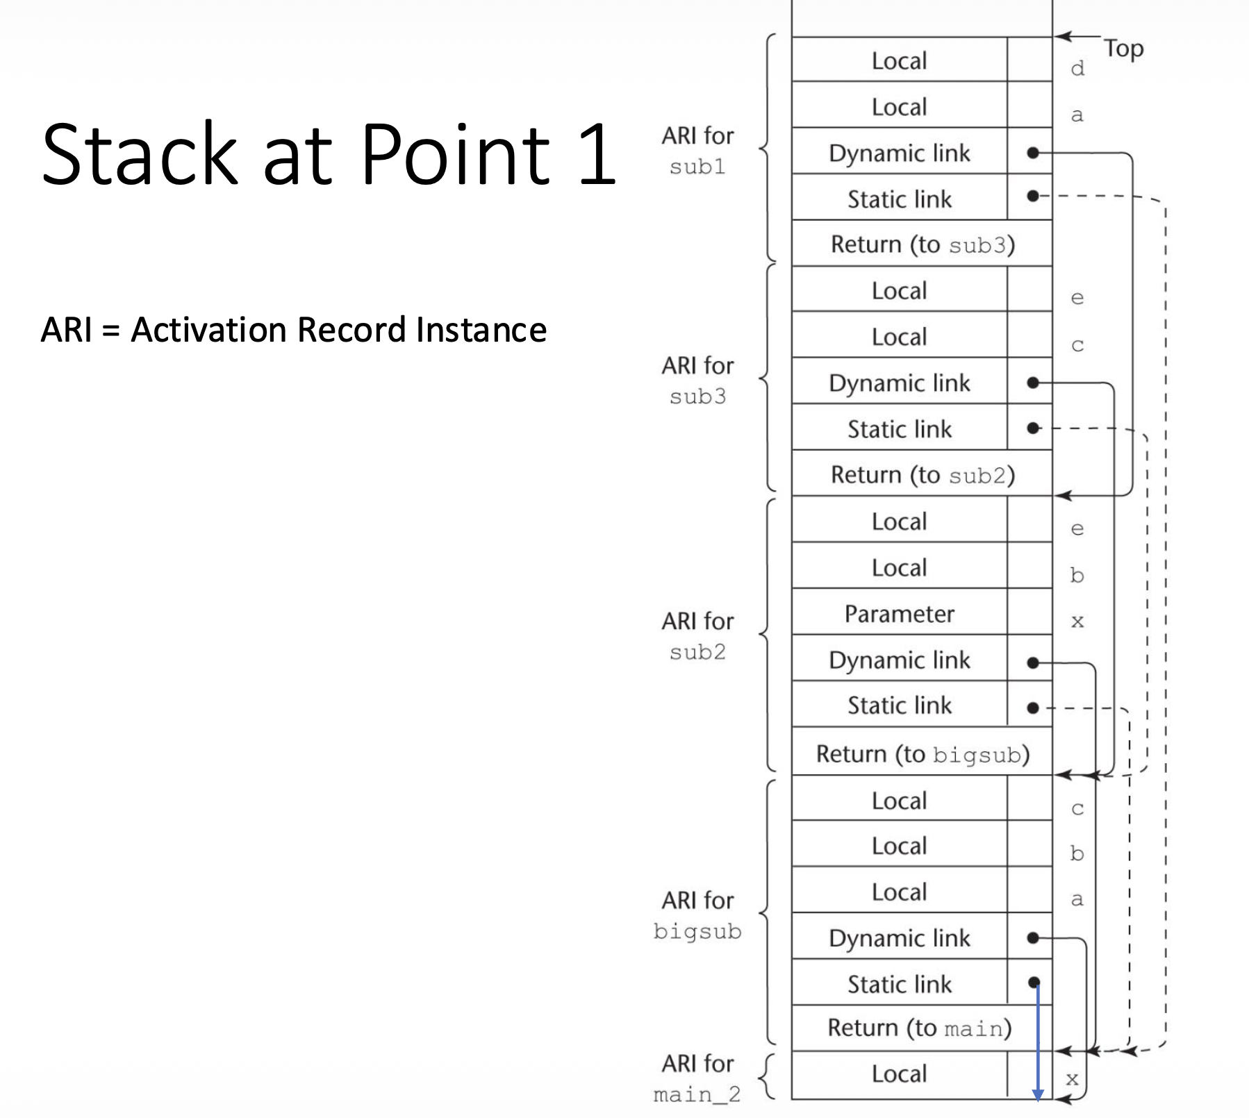

Slide 41
